Slide 1
OBAMA SHOOTING
Python Game Development Project
By team pycoders
Guided By Rizwan UR Rahman Sir

Slide 2

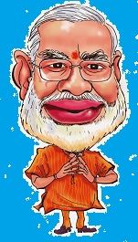
Obama Shooting – a basic run and hit game has been built on python platform.
Keys have been described while in the game.
It uses some basic packages like PYGAME, random, time etc.
We have used Sprite class.

Slide 3
Sprite class
Sprite class is intended to be used as a base class for different types of objects in game.
It is efficient in adding and removing sprites.
We have used here spritecollide(),group(),add() etc. functions for our use in the game.
Converted every image to image.rect() for working efficiently with sprite class.

Slide 4
Pygame provides functions for creating programs with a graphical user interface, or GUI.
It has built in functions to make real time games possible that can show a window with images and colors
We have used pygame’s font, time, event etc. functions here.
Pygame

Slide 5
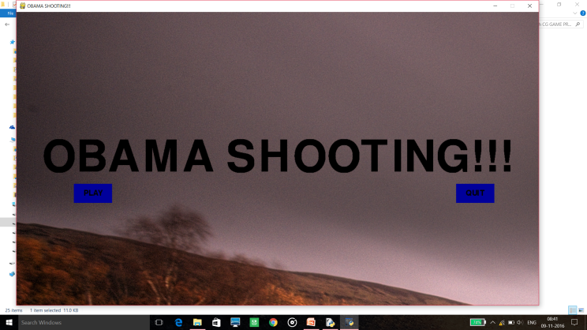
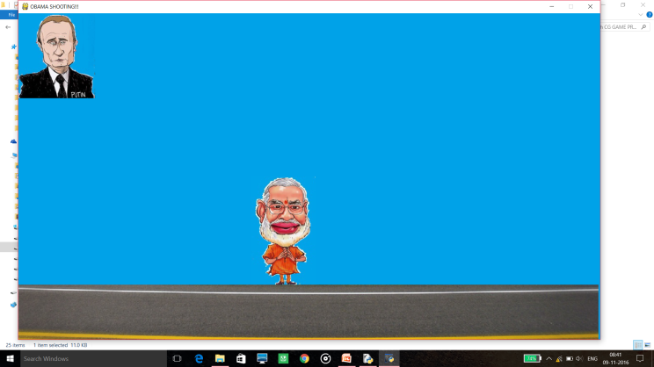
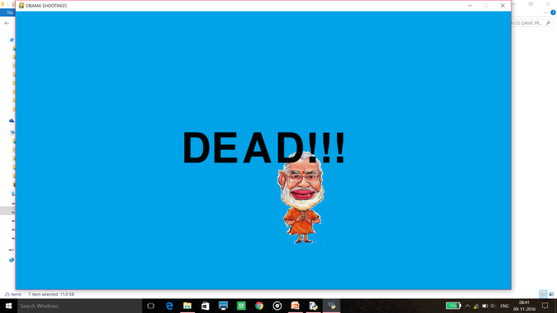
Game description
Included a Game Intro screen, game screen and a game over screen.
Images appear randomly on screen anywhere thus increasing the difficulty of game every instant.
Our protagonist has to hit the shoe to the random appearing images before they disappear.

Slide 6
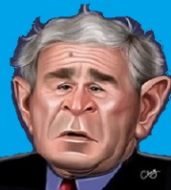
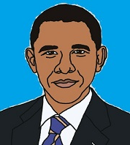
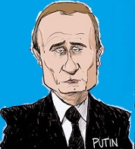
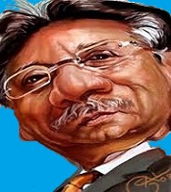
Specials
Power ups:
Use Shoes to hit either one of the people- Obama, Bush, Putin and Musharraf.
Sounds for every miss of shoes and thud for a hit so that game appears lively.

Slide 7
Further Projects:
To increase the level of game from beginner to mediocre or professional
To use new packages like OPEN GL
To try this on platforms like JAVA

Slide 8
For any further queries: contact :- prakharjain927@gmail.com
THANK YOU
Team members:- 1.Prakhar Jain 151112230
2.Prajal Jain 151112239
3.Ayush Patidar 151112227
4.Nayan Dhakad 151112245
5.Sawan Kaulic 151112294
6.Ayush Yogi 151112247

